Slide 1


Health Economics Lecture #9
Topic: Sensitivity Analysis
Prepared by Jacob Smith, Trent University

Slide 2
Learning Objectives
In this lecture, we will discuss:
What is sensitivity analysis?
One-way sensitivity analysis.
Two-way sensitivity analysis.
Probabilistic Sensitivity Analysis and the CEAC
Net Monetary Benefits and Net Health Benefits
Sketching the CEAC by hand.
Goal of this Lecture:
Introduce the idea of sensitivity analysis
Understand how sensitivity analysis supports the robustness of model results

Slide 3
What is sensitivity analysis?

Slide 4
Sensitivity Analysis
Recall, the purpose of a model in the context of a cost effectiveness analysis is to compute expected costs, expected effects/utilities/benefits, and the corresponding Incremental Cost-Effectiveness Ratio (ICER).
One concern regarding a model’s output is that the results reported are entirely dependent on the model’s parameters.
In order for research to be useful, there needs to be some generalizability. To do so, there needs to be a demonstration of how the results presented are “robust” to other parameter values.

Slide 5
Types of Sensitivity Analysis
There are three type of sensitivity analysis:
One-way sensitivity analysis.
Two-way sensitivity analysis.
Probabilistic sensitivity analysis.
The first two on this list are often grouped together and called Deterministic Sensitivity Analysis.
This lecture will distinguish between the two in order that their methods are well defined.

Slide 6
What do we apply sensitivity analysis to?
There may be uncertainty about different parts of a model not limited to but including:
Probability of events.
Costs in each state of the model.
Utilities in each state of a model.
Ultimately we are interested in seeing how the variation in model impacts the computed ICER which defines the cost-effectiveness the drug or technology in question.

Slide 7
One Way Sensitivity Analysis

Slide 8
One-way Sensitivity Analysis
In one-way sensitivity analysis is when we vary a single model parameter at a time to determine its effect on the computed ICER.
The simplest way to do this, a “High” case where the parameter value is 50% larger than the base specification and a “Low” case when the parameter value is 50% lower from the base specification.
Note: in a one-way sensitivity analysis all other parameter values are held constant. This is done to determine the role each parameter plays.

Slide 9
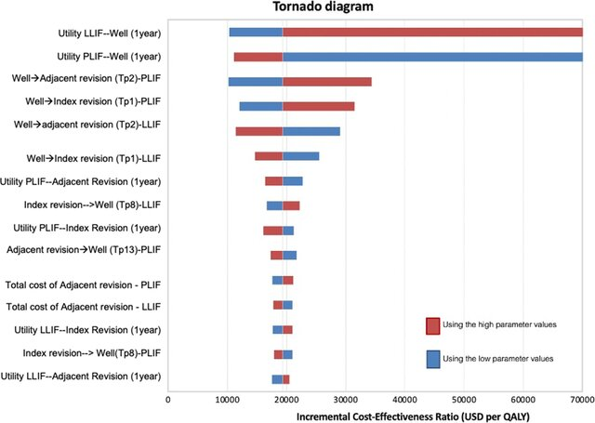
Tornado Diagrams
One of the two ways of presenting deterministic sensitivity analysis.
It displays the responsiveness each input has to variation in value for high and low cases with the more responsive parameters typically at the top with less responsive parameters closer to the bottom.
Researchers may want to display separate charts for costs and effects respectively in order to provide a comprehensive insight in the model’s sensitivity.
Figure from: Boonsirikamchai, W., Phisalpapra, P., Kositamongkol, C., Korwutthikulrangsri, E., Ruangchainikom, M., & Sutipornpalangkul, W. (2023). Lateral lumbar interbody fusion (LLIF) reduces total lifetime cost compared with posterior lumbar interbody fusion (PLIF) for single-level lumbar spinal fusion surgery: a cost-utility analysis in Thailand. Journal of orthopaedic surgery and research, 18(1), 115.

Slide 10
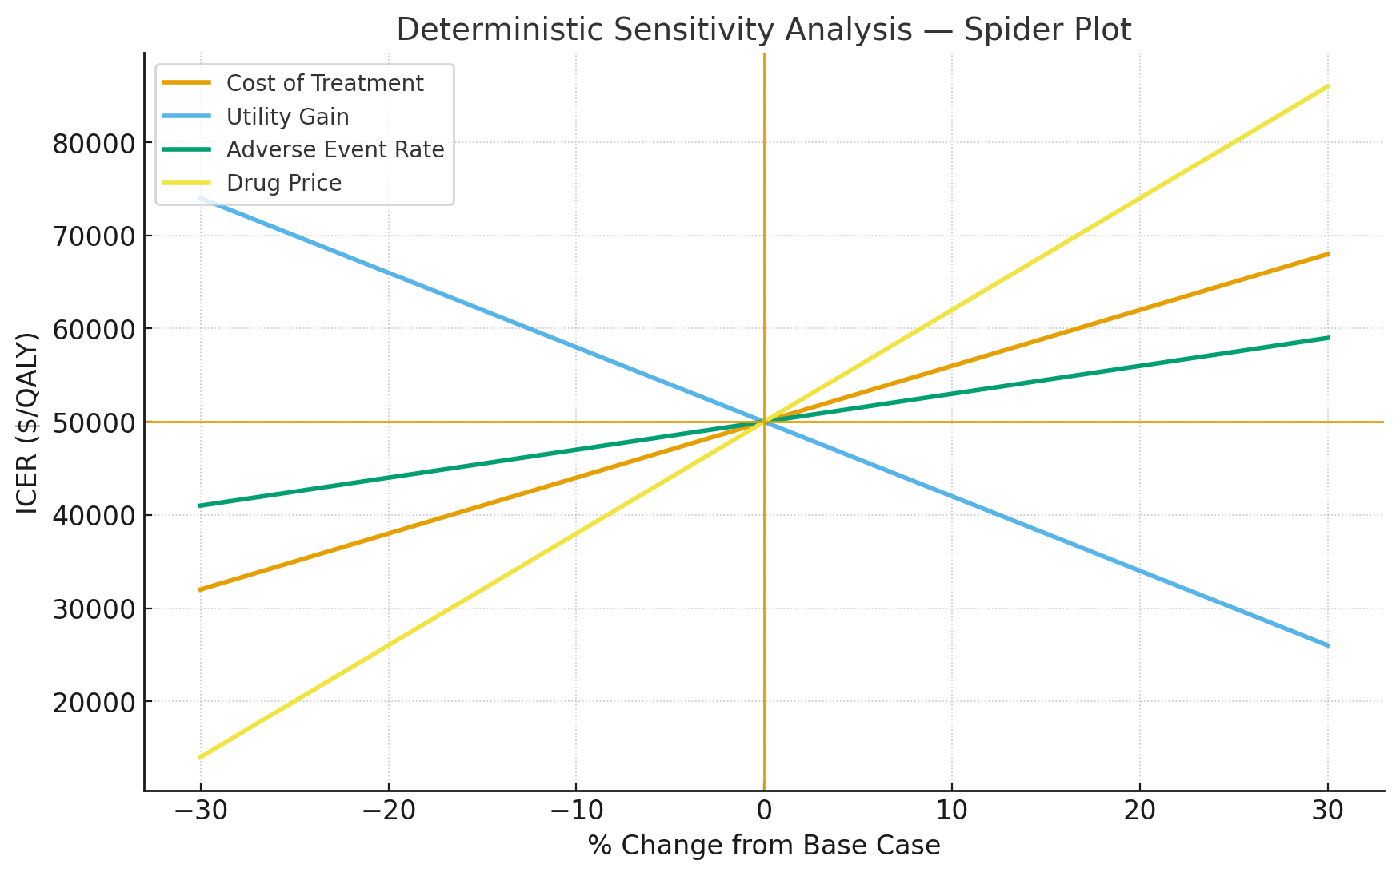
Spider Plots
Spider plots are ideal when we wish to continuously vary parameter values in a cost effectiveness model.
This means we don’t just consider a High and low case, but change parameters in other increments.
Computationally, these figures can be complex but the nature of model sensitivity can be much more clearly observed.
This is a less common figure seen among reported one-way sensitivity analysis.

Slide 11
Two-Way Sensitivity Analysis

Slide 12
Two Way Sensitivity Analysis
Two-way sensitivity analysis is conducted when we are interested in how two parameters impact the output of a model together.
This analysis is often justified when we suspect that model parameters are correlated with each other (i.e, the varying of one parameter will necessarily impact the value of another).

Slide 13
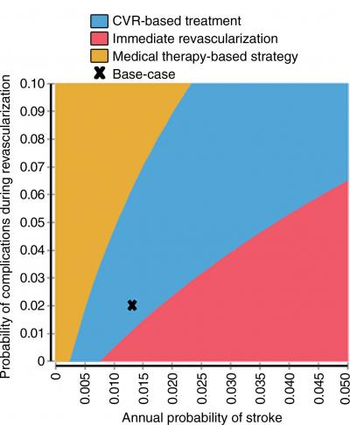
Two way sensitivity analysis plot
In a two way sensitivity analysis we create a strategy selection map.
With this plot we can identify which treatments are cost effective conditional on pairs of parameter values.
The plot’s advantage is that it shows directly how changing the models parameters over a range of values can impact the main results.
A disadvantage is that it can only consider two parameters at a time, while in the one-way analysis we can add every parameter on the same plot.
Source: Radiological Society of North America https://www.eurekalert.org/multimedia/920184

Slide 14
Probabilistic Sensitivity Analysis

Slide 15
Probabilistic Sensitivity Analysis
In Probabalistic Sensitivity Analysis, we vary all the parameters at the same time.
This is done by drawing model parameters from predefined distributions and computing the model many times.
In each draw a new valuation of costs, effects and the ICER is computed.
The idea behind PSA is that it wants to consider all possible outcomes which may be simulated from a model.

Slide 16


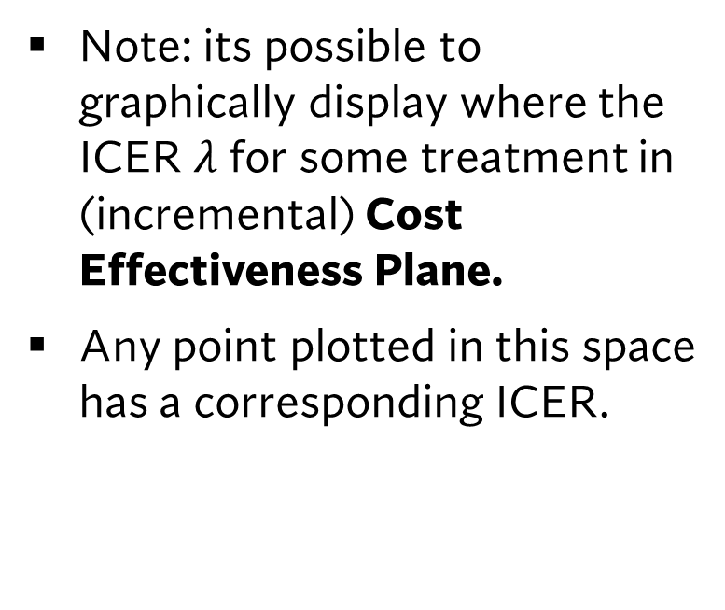



The cost effectiveness plane and the ICER
$$ΔC$$
Note: its possible to graphically display where the ICER $λ$ for some treatment in (incremental) Cost Effectiveness Plane.
Any point plotted in this space has a corresponding ICER.
$$ΔC^{A}$$
$$λ^{A}=ΔC^{A}/ΔE^{A}$$
0
0
$$ΔE^{A}$$
$$ΔE$$

Slide 17
PSA and the CE Plane
$$ΔC$$
When a probabilistic sensitivity analysis is conducted, we compute many different ICERs.
Typically, analysts run 10,000 simulations to get a rough sense of all possible outcomes.
$$ΔE$$

Slide 18
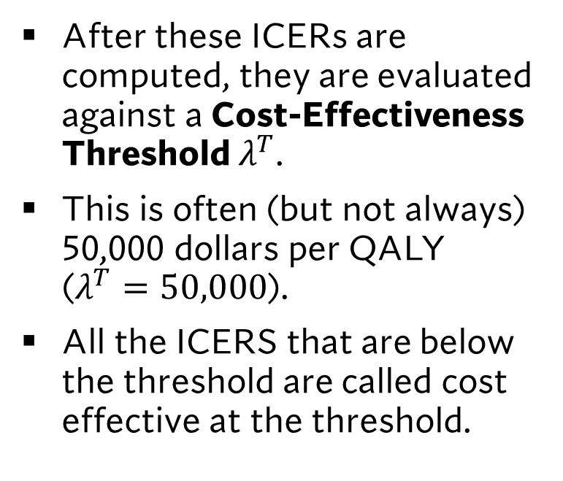

PSA and the CE Plane
$$ΔC$$
$$λ^{T}$$
After these ICERs are computed, they are evaluated against a Cost-Effectiveness Threshold $λ^{T}$.
This is often (but not always) 50,000 dollars per QALY ($λ^{T}=50,000$).
All the ICERS that are below the threshold are called cost effective at the threshold.
$$ΔE$$

Slide 19
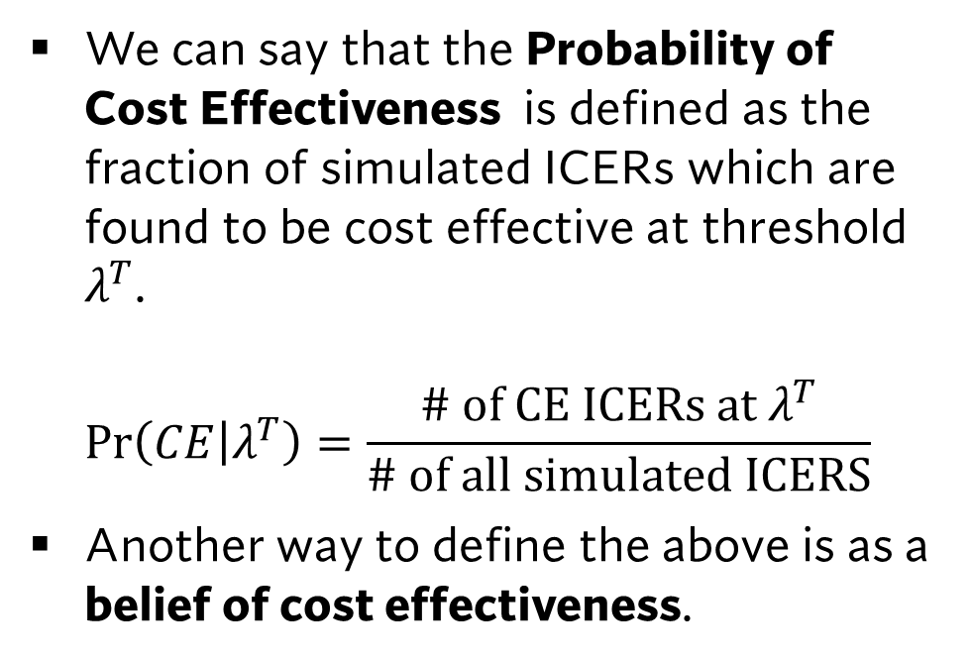
PSA and the CE Plane
$$ΔC$$
$$λ^{T}$$
We can say that the Probability of Cost Effectiveness is defined as the fraction of simulated ICERs which are found to be cost effective at threshold $λ^{T}$. $\operatorname{Pr}\left(CE | λ^{T}\right)=\frac{\# of CE ICERs at λ^{T}}{\# of all simulated ICERS}$
Another way to define the above is as a belief of cost effectiveness.
$$ΔE$$

Slide 20
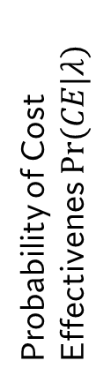

The Cost Effectiveness Acceptability Curve.
We can take probabilistic sensitivity analysis further with the use of the Cost Effectiveness Acceptability Curve.
This curve tells us the probability of cost effectiveness over a range of threshold values.
1
CEAC
Probability of Cost Effectivenes $Pr(CE|λ)$
0
Threshold Value $λ$

Slide 21


The Cost Effectiveness Acceptability Curve.
Often researchers will display the CEAC along with the “fixed” threshold value $λ^{T}$.
$$λ^{T}$$
1
CEAC
Probability of Cost Effectivenes $Pr(CE|λ)$
0
Threshold Value $λ$

Slide 22
Net Monetary Benefits and Net Health Benefits

Slide 23


The cost effectiveness plane and the ICER
$$ΔC$$
More Costly, Less Effective (Never Cost Effective)
More Costly, More Effective (Can be cost effective)
The Cost effectiveness plane can be divided into 4 quadrants.
We can easily interpret an ICER in each of these quadrants.
Two important quadrants are the 2nd and 4th quadrant where regardless of threshold value a ICER will be cost effective or not.
0
Less Costly, Less Effective (Can be cost effective)
0
$$ΔE$$
Less Costly, More Effective (Always Cost Effective)

Slide 24

The Problem with Negative ICERs
Suppose we have an ICER of $λ=−10$.
This can be any point along the ray in this figure
$$ΔC$$
$$ΔE$$

Slide 25
The Problem with Negative ICERs
The problem here is that this ICER can correspond to treatments that are less costly and more effective and treatments that are more costly and less effective.
These are very different results!
Given this fact, how can we practically compute the CEAC?
$$ΔC$$
More Costly Less Effective
$$ΔE$$
Less Costly, More Effective

Slide 26
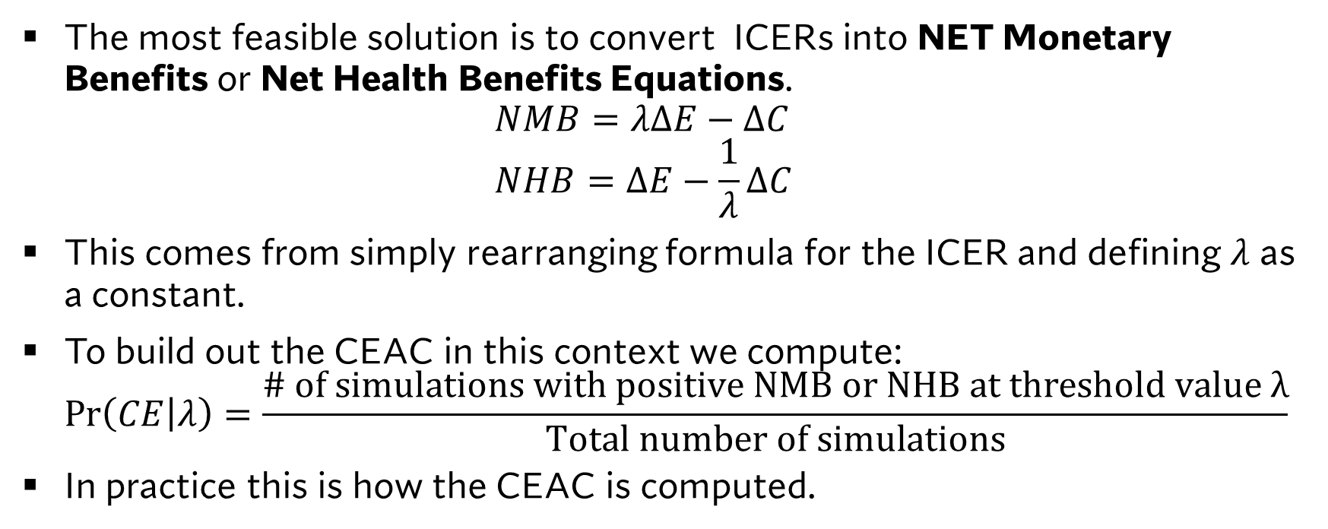
The Solution: Net Health Benefits and Net Monetary Benefits
The most feasible solution is to convert ICERs into NET Monetary Benefits or Net Health Benefits Equations. $NMB=λΔE−ΔC$ $NHB=ΔE−\frac{1}{λ}ΔC$
This comes from simply rearranging formula for the ICER and defining $λ$ as a constant.
To build out the CEAC in this context we compute: $\operatorname{Pr}\left(CE | λ\right)=\frac{\# of simulations with positive NMB or NHB at threshold value λ}{Total number of simulations}$
In practice this is how the CEAC is computed.

Slide 27
Sketching the CEAC by hand

Slide 28





Sketching the CEAC by hand.
Consider the following CE plane with 100 simulated ICERS. Sketch the cost effectiveness acceptability curve
$$ΔC$$
N=10
N=50
$$Pr⁡(CE|λ)$$
$$ΔE$$
N=30
N=10
$$0$$
$$λ^{T}$$

Slide 29




Sketching the CEAC by hand.
Consider the following CE plane with 100 simulated ICERS. Sketch the cost effectiveness acceptability curve
$$ΔC$$
N=10
N=50
$$Pr⁡(CE|λ)$$
$$ΔE$$
$$0.4$$
N=30
N=10
$$λ^{T}=0$$
$$\operatorname{Pr}\left(CE | 0\right)=\frac{40}{100}$$
$$0$$
$$λ$$
Step 1: Compute the probability of cost effectiveness at $λ=0$

Slide 30
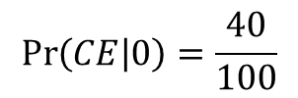

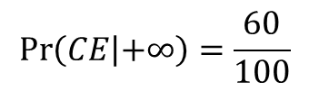

Sketching the CEAC by hand.
Consider the following CE plane with 100 simulated ICERS. Sketch the cost effectiveness acceptability curve
$$ΔC$$
$$λ^{T}=+∞$$
N=10
N=50
$$Pr⁡(CE|λ)$$
$$0.6$$
$$\operatorname{Pr}\left(CE | +∞\right)=\frac{60}{100}$$
$$ΔE$$
$$0.4$$
N=30
N=10
$$\operatorname{Pr}\left(CE | 0\right)=\frac{40}{100}$$
$$0$$
$$λ$$
Step 2: Compute the probability of cost effectiveness at $λ=+∞$

Slide 31
Sketching the CEAC by hand.
Consider the following CE plane with 100 simulated ICERS. Sketch the cost effectiveness acceptability curve
$$ΔC$$
$$λ^{T}=+∞$$
N=10
N=50
$$Pr⁡(CE|λ)$$
$$0.6$$
$$\operatorname{Pr}\left(CE | +∞\right)=\frac{60}{100}$$
$$ΔE$$
$$0.4$$
N=30
N=10
$$\operatorname{Pr}\left(CE | 0\right)=\frac{40}{100}$$
$$0$$
$$λ$$
Step 3: Connect these points with a curve

Slide 32
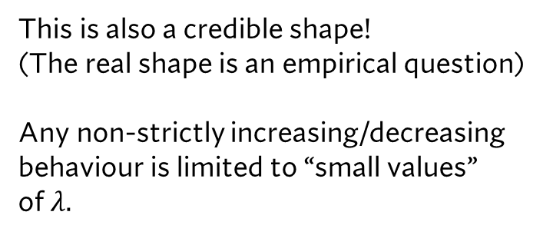
Sketching the CEAC by hand.
Consider the following CE plane with 100 simulated ICERS. Sketch the cost effectiveness acceptability curve
$$ΔC$$
$$λ^{T}=+∞$$
N=10
N=50
$$Pr⁡(CE|λ)$$
$$0.6$$
This is also a credible shape! (The real shape is an empirical question) Any non-strictly increasing/decreasing behaviour is limited to “small values” of $λ.$
$$ΔE$$
$$0.4$$
N=30
N=10
$$0$$
$$λ$$
Step 3: Connect these points with a curve

Slide 33
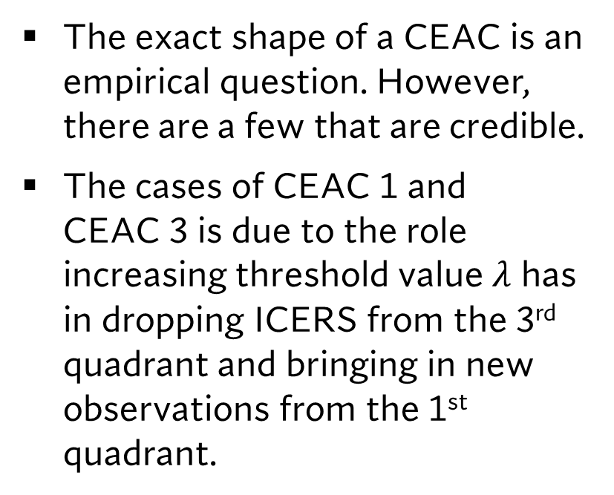
The many shapes of the CEAC
The exact shape of a CEAC is an empirical question. However, there are a few that are credible.
The cases of CEAC 1 and CEAC 3 is due to the role increasing threshold value $λ$ has in dropping ICERS from the 3rd quadrant and bringing in new observations from the 1st quadrant.
1
CEAC 1
CEAC 2
Probability of Cost Effectivenes $Pr(CE|λ)$
CEAC 3
CEAC 4
0
Threshold Value $λ$

Slide 34
A CEAC Shapes we can never have
Its important to note, that the CEAC will never oscillate or inflect at large threshold values.
This is because these shapes are IMPOSSIBLE based on how the CEAC is computed.
1
CEAC 5
CEAC 6
Probability of Cost Effectivenes $Pr(CE|λ)$
CEAC 7
0
Threshold Value $λ$

Slide 35
Learning Objectives
In this lecture, we will discuss:
What is sensitivity analysis?
One-way sensitivity analysis.
Two-way sensitivity analysis.
Probabilistic Sensitivity Analysis and the CEAC
Net Monetary Benefits and Net Health Benefits
Sketching the CEAC by hand.
Goal of this Lecture:
Introduce the idea of sensitivity analysis
Understand how sensitivity analysis supports the robustness of model results

